Slide 1
2006
CSTI’s
COLORFUL
ROADMAP

Slide 2
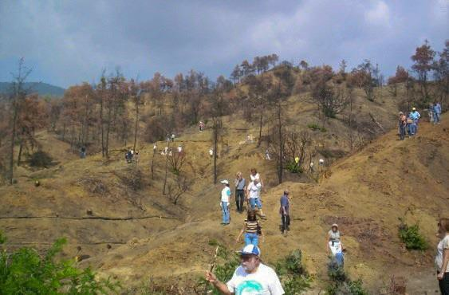
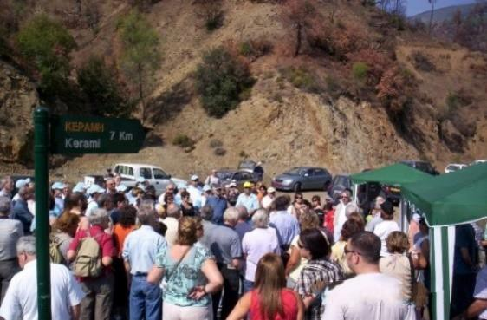
CSTI was officially established.
Affiliated with the Travel
Foundation
2006
2006-
2010
6 Village Routes - ‘Discover the Real Cyprus – A Self Drive Tour to Create Your Own Adventure’
For the first time the Cyprus Tourism industry
was mobilized
to plant almost 1000 trees after the devastating fires at Fylagra
2008
2007
Water & energy saving project in the hotel industry saved more than 1/2 million euro in water & energy in less than 6 months

Slide 3
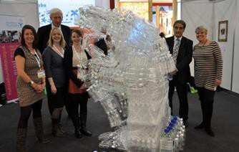
We organized The international Waste Management Conference with the University of Nicosia
2009
2010-
2011
2011
Make Hotels Greener
Plastic Reduction Initiative
with Thomas Cook

Slide 4
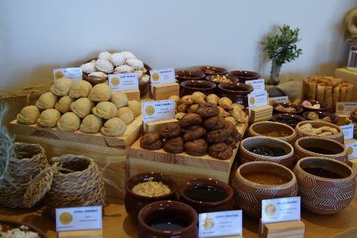
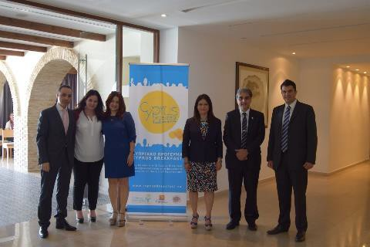
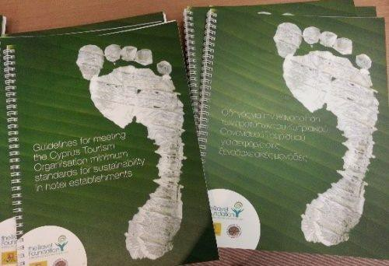
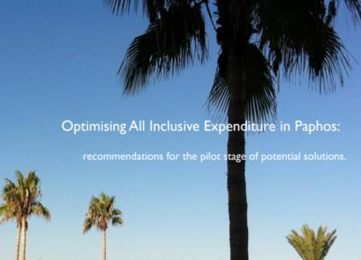
The Cyprus Destination Partnership (CDP)
5-Year Partnership Agreement
between the Travel Foundation, CTO & CSTI
2010-2015
Greening Cyprus Beaches
2011-
2012
Cyprus Breakfast
2013-
2015
Waste Mapping
2013-
present
2014
Minimum Sustainable Standards (MSS)
2014-
2015
2015
Cyprus won the Silver Award as the “Best Destination for Responsible Tourism“ at the WTM
for the Minimum Sustainable Standards (MSS)
Optimising All Inclusive Customer spend in the Paphos Economy

Slide 5
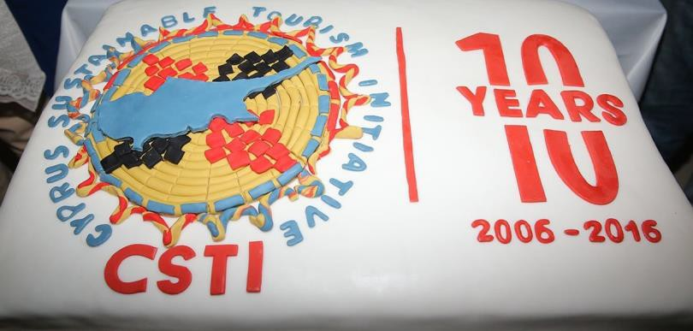
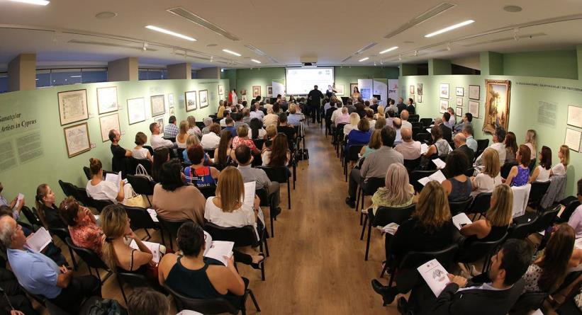
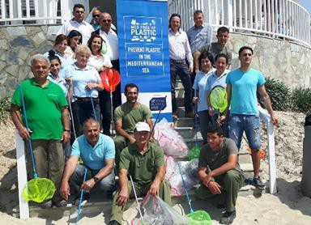
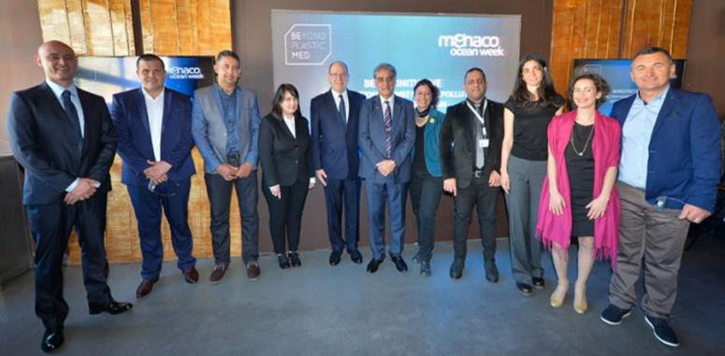
CSTI’s Cooperation with the Prince Albert II of Monaco Foundation started
2016
2006-
2016
10 Year Celebration
with
‘Sustainability is Culture’
Event
‘Prevent Plastic in the Mediterranean Sea’ - Beyond Plastic Med Project awarded by the Prince Albert II of Monaco Foundation
2017-
2018

Slide 6
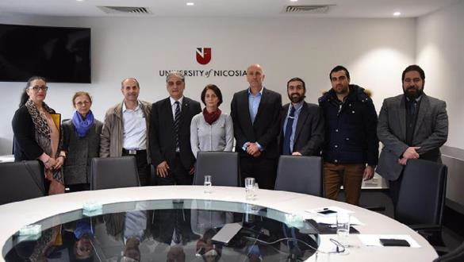
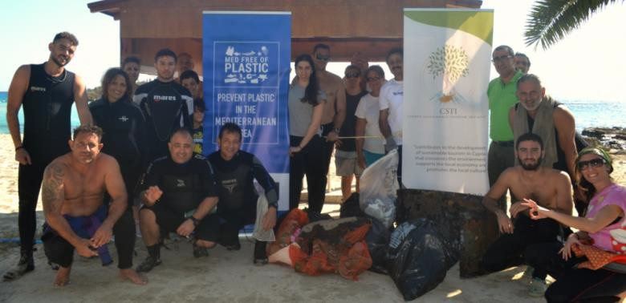
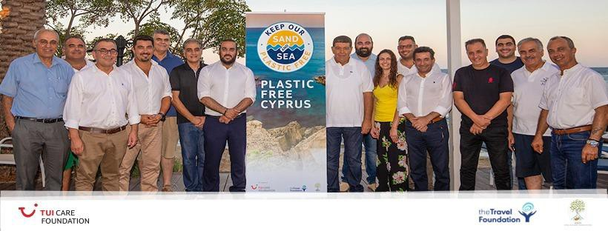
A 5-year Memorandum of Understanding (MOU) signed with the University of Nicosia
‘Plastic Free Entertainment Cruises & Water Sport Activities’
Beyond Plastic Med Project awarded by the Prince Albert II of Monaco Foundation
2019
2019-
2020
2019-
2022
‘Keep Our Sand and Sea Plastic Free’ Project launched –
An initiative of
TUI Care Foundation
Delivered by Travel Foundation in partnership with CSTI
‘Our beaches
Our treasures –
Let’s protect them!’ Campaign
2020

Slide 7
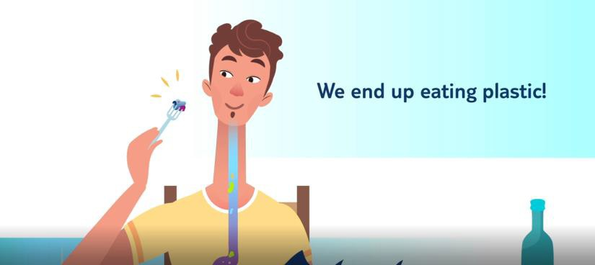
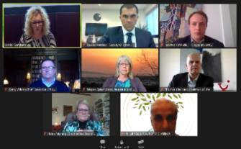
IUCN launched the Plastic Waste-Free Islands Med Project (PWFI) in Cyprus with CSTI in Collaboration with Together Cyprus
2020-
2022
.
2021
‘Keep Our Sand & Sea Plastic
Free’ Animation Release
2020
2006-
2021
15 Year Celebration with ‘1st Online International Conference
‘Sustainable Future – In Every Crisis there is an Opportunity’
Proud Signatory of the Global Tourism Plastics Initiative - the first from Cyprus to join
.

Slide 8
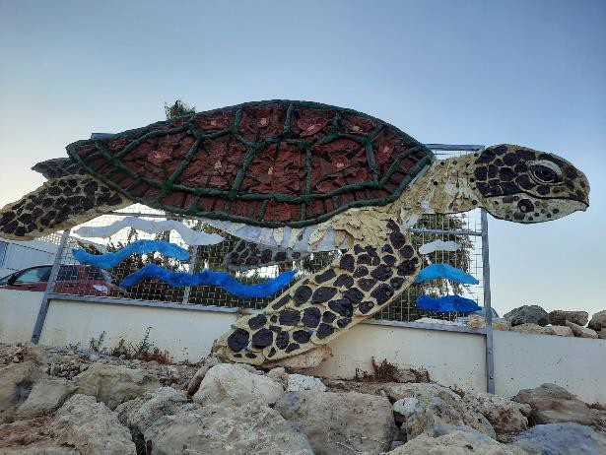
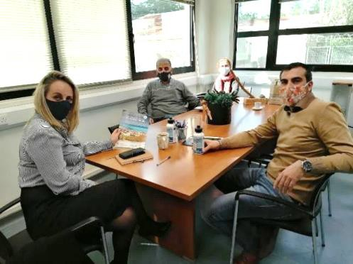
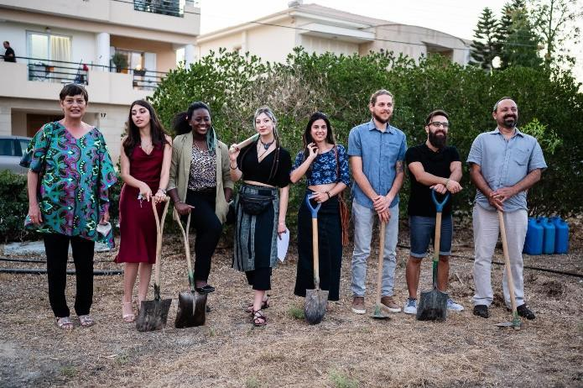
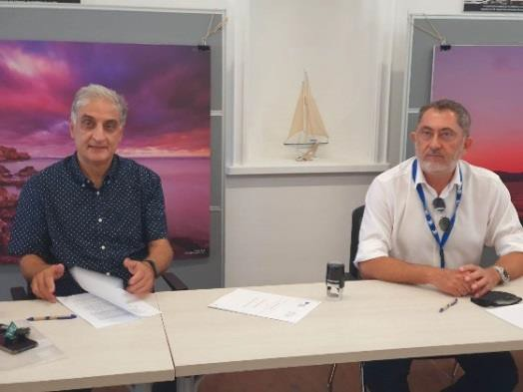
Memorandum of Understanding (MOU) signed with the Commissioner of the Environment
2021
2021
‘Keep Our Sand And Sea Plastic Free’
Project launched - The First Plastic Free Beach & unveiled the CALYPSO artwork – a turtle made from waste – to raise awareness at Ayia Triada Beach, Cyprus
2021
2021
The best design proposals for the First Sustainable Park in Nicosia were awarded by CSTI, the University of Nicosia and the Municipality of Engomi followed by a symbolic tree planting
An open-ended Memorandum of Understanding (MOU) signed with the CMMI Cyprus Marine and Maritime Institute

Slide 9
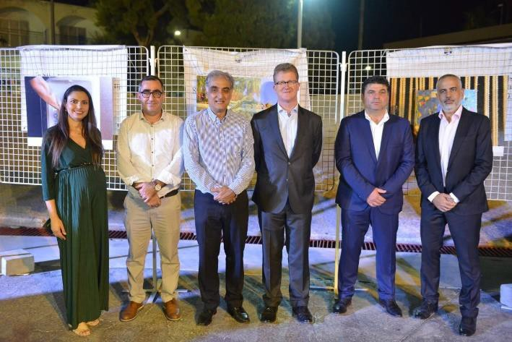
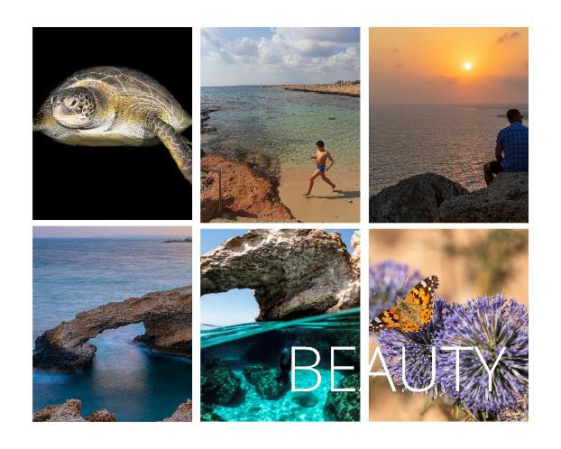
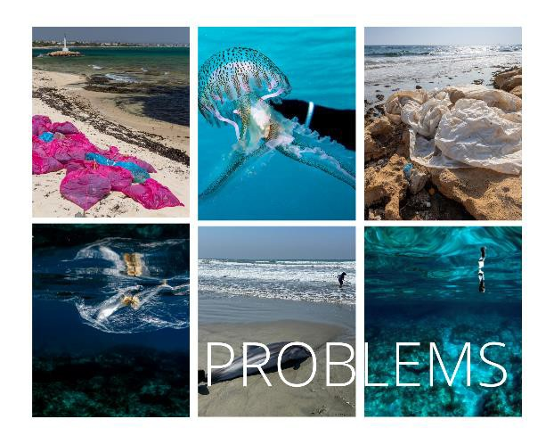
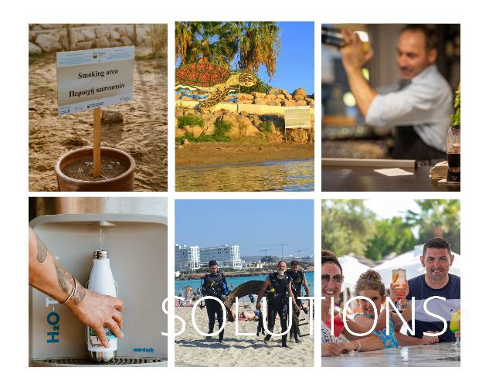
Photo exhibition on the theme of
‘Plastic Pollution- another threat to the beauty of our sand and
sea & key contributor to environment degradation’
in cooperation with the British High Commission in connection with COP26 which is touring the island
2021
2019-
2021
The Domognostics+ Platform is up & running with Semantically enhanced IoT – enabled Building Analytics and Diagnostics
The Consortium:
2021
Proud Launch Partner & Signatory of the Glasgow
Declaration on Climate Action in Tourism.
PHOEBE Research & Innovation
KIOS CoE CSTI

Slide 10
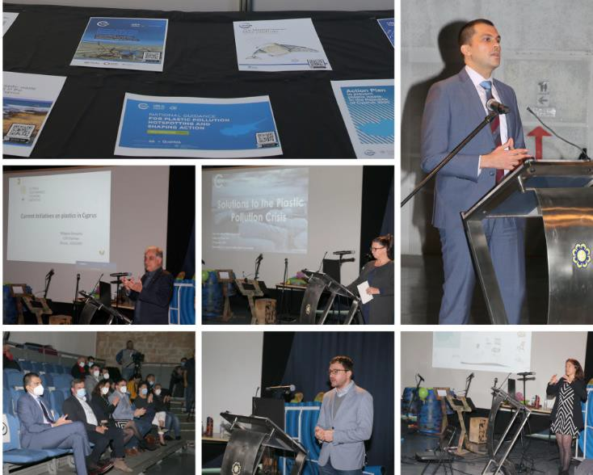
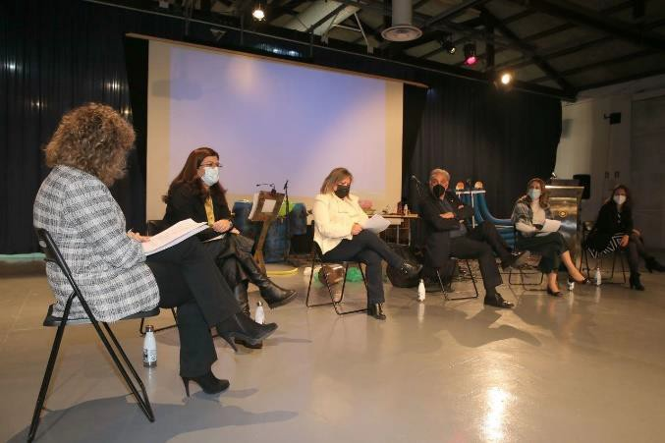
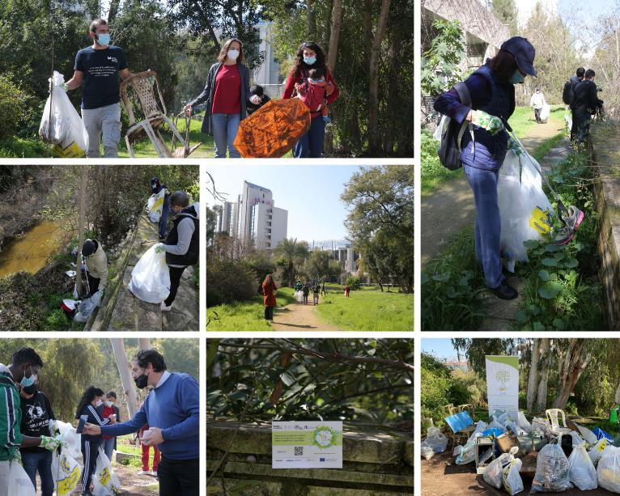
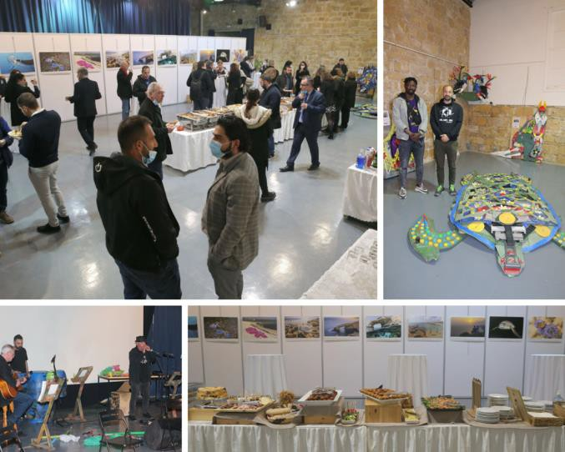
The final event of the Plastic Waste Free
Islands Med (PWFI) Project sent the clear message that urgent &
collective action is needed to tackle plastic pollution in the
Mediterranean.
2022
The IUCN Plastic Waste-Free Islands Med Project (PWFI) in Cyprus was wrapped up successfully by CSTI in Collaboration
with Together Cyprus
Final Event
Thursday 17.2.2022
Melina Mercouri Hall, Nicosia
2022
Panel Discussion with the subject
“Tackling Plastic Pollution”
Successful Pedieos River Clean-Up Campaign with the Plastic
Waste Free Islands Project
Wednesday 16.2.2022

Slide 11
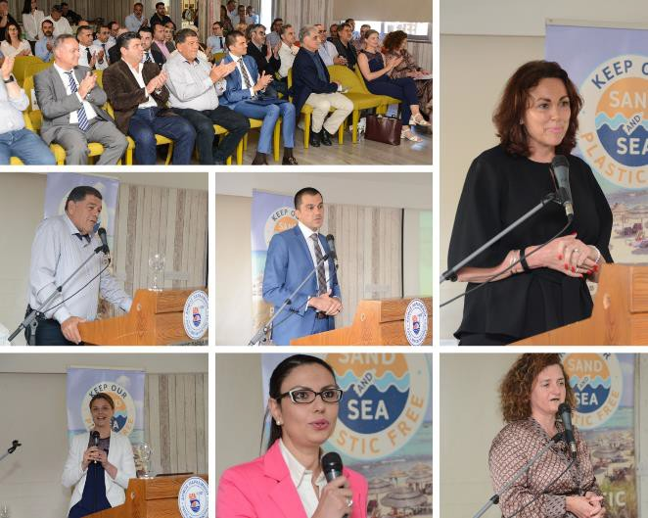
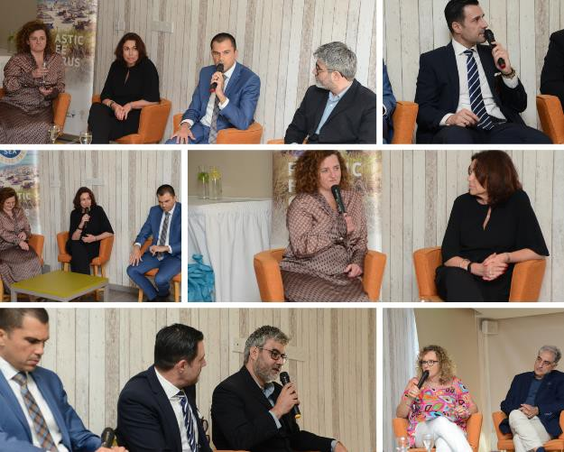
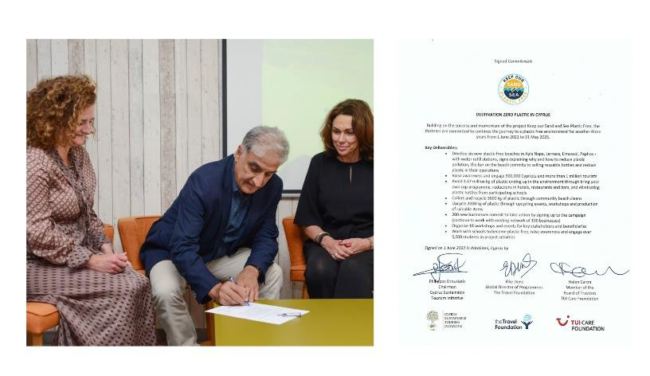
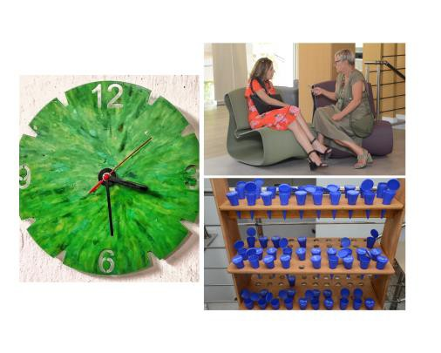
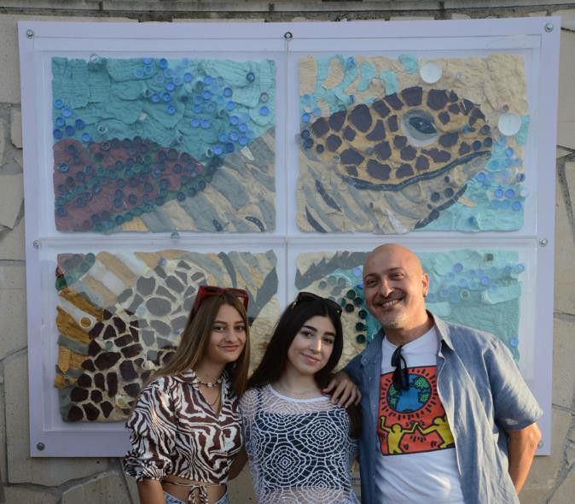
“Keep Our Sand And Sea Plastic Free” Project Celebration Wednesday 1.6.2022
Malama Beach Holiday Village
Phase I was wrapped up with great results!
2022
Launch of 2nd Plastic Free Beach
Moderated Panel Discussion: ‘Destination Zero Plastic Waste: can Cyprus Tourism lead the way?’
at Skoutari Beach, Paralimni
‘NEFELI’
aims to raise awareness regarding the burning issue of plastic pollution in our seas.
Destination Zero Plastic in Cyprus The continuation of the Project for the next 3 years (1/06/2022-31/05/2025) was officially announced with the extension to Larnaca, Limassol & Paphos.
Upcycling Display

Slide 12
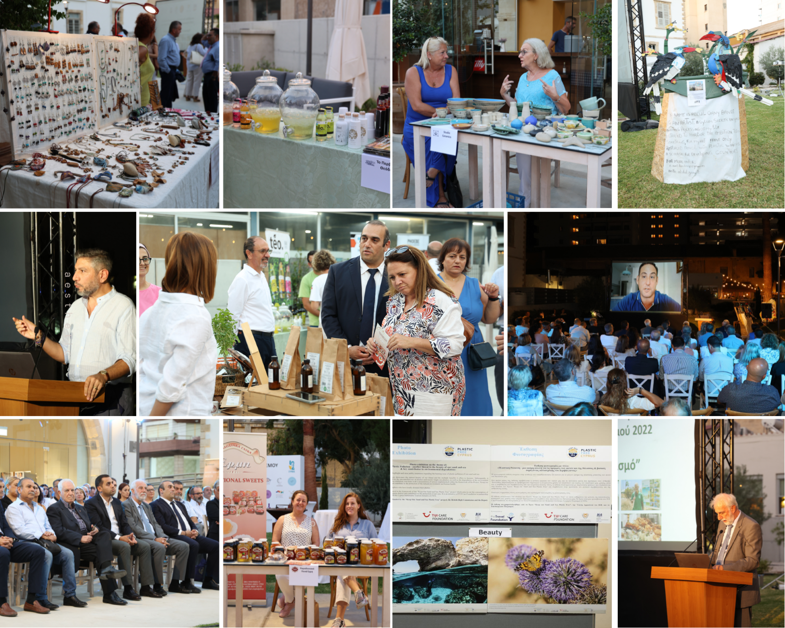
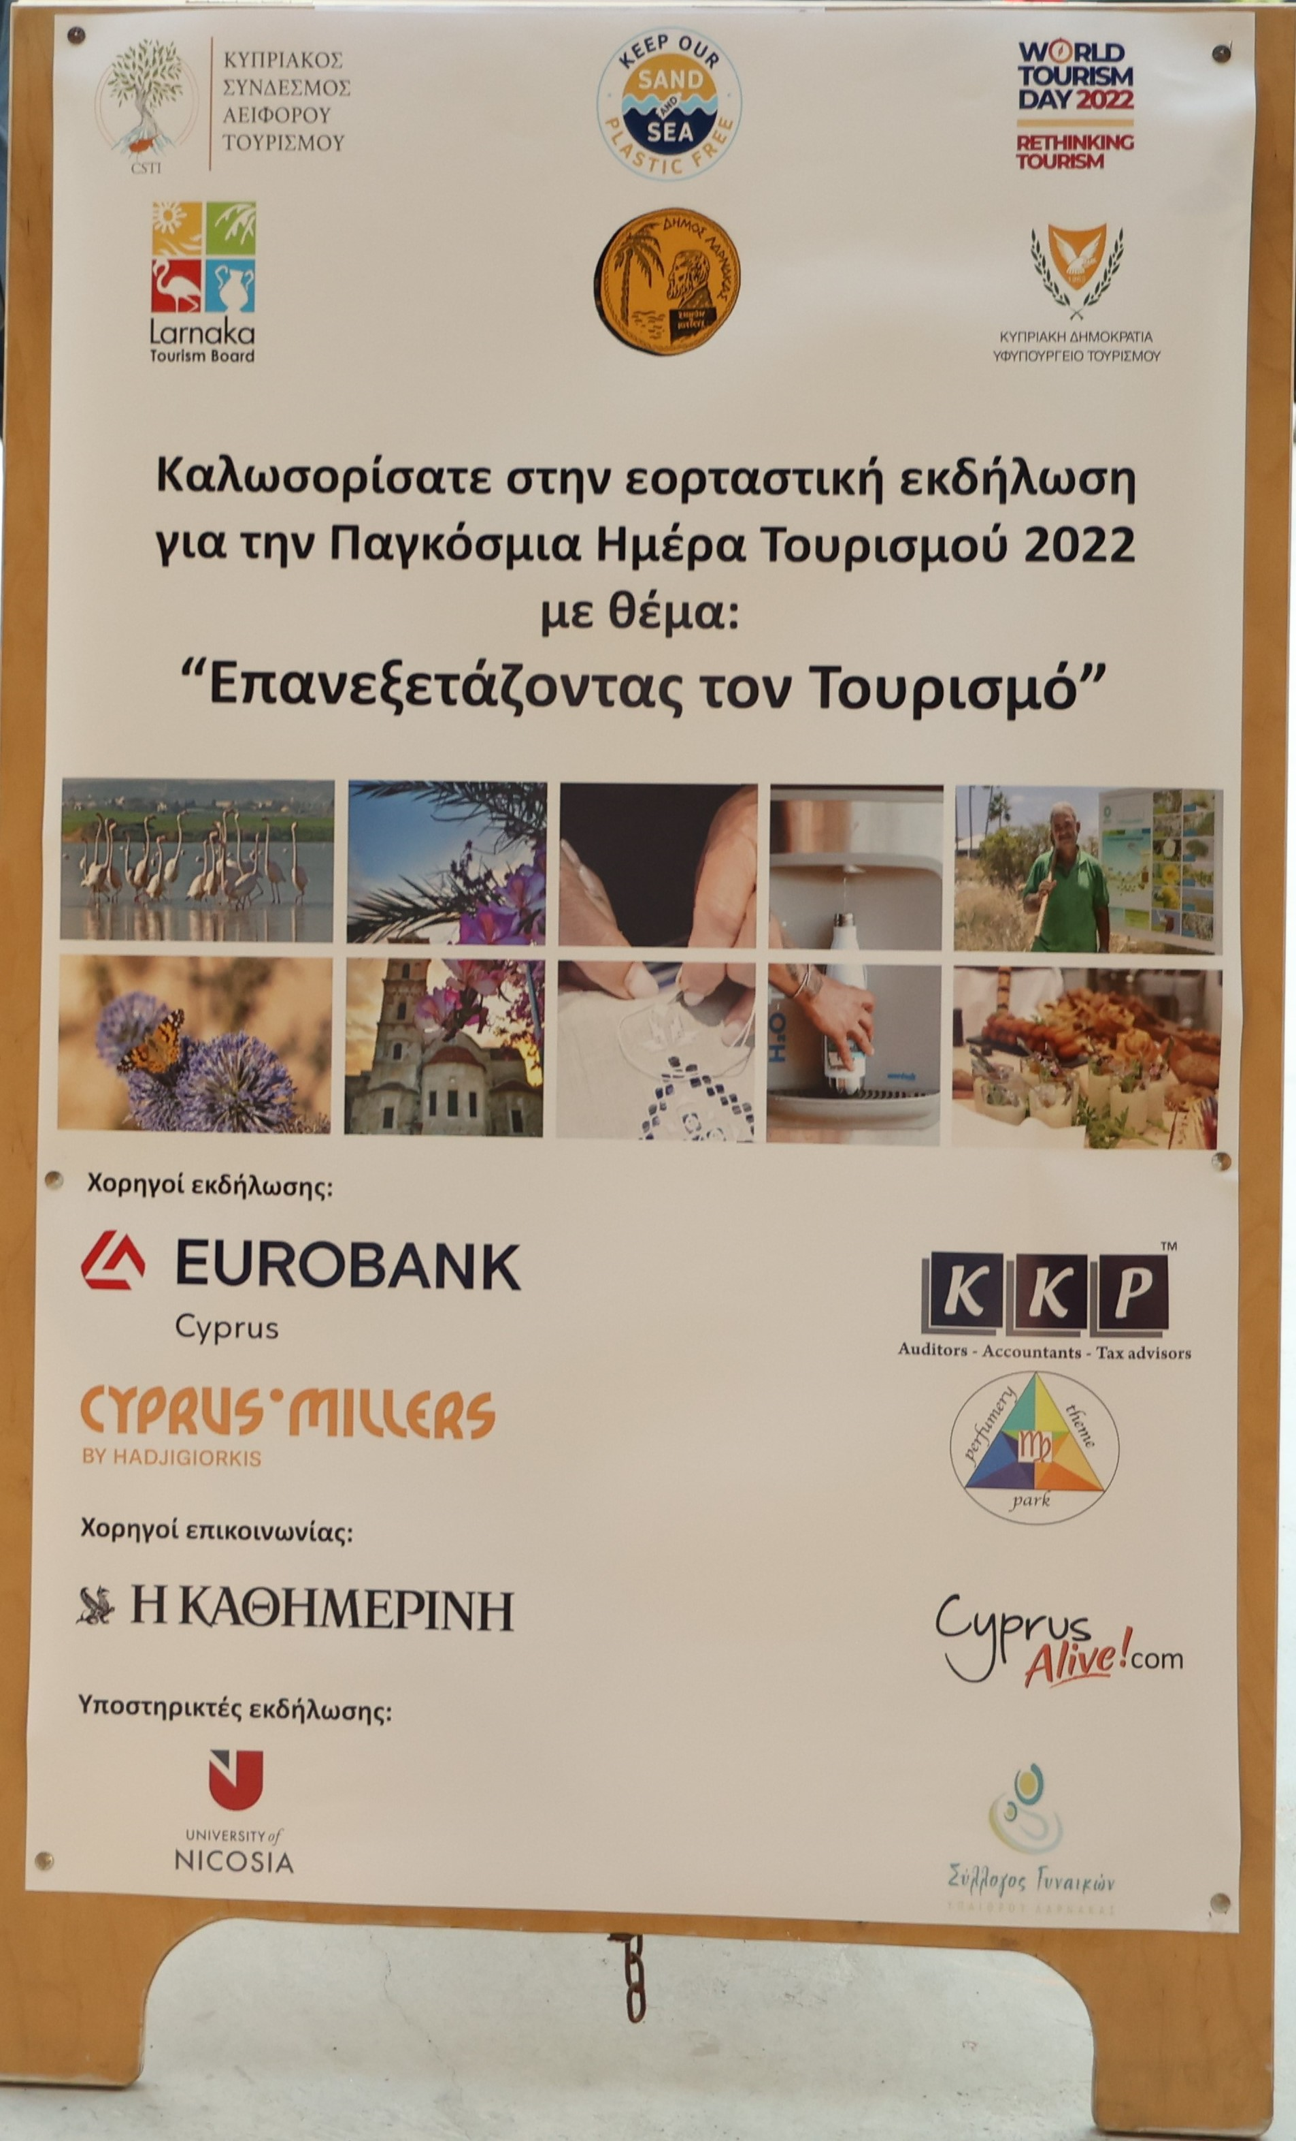
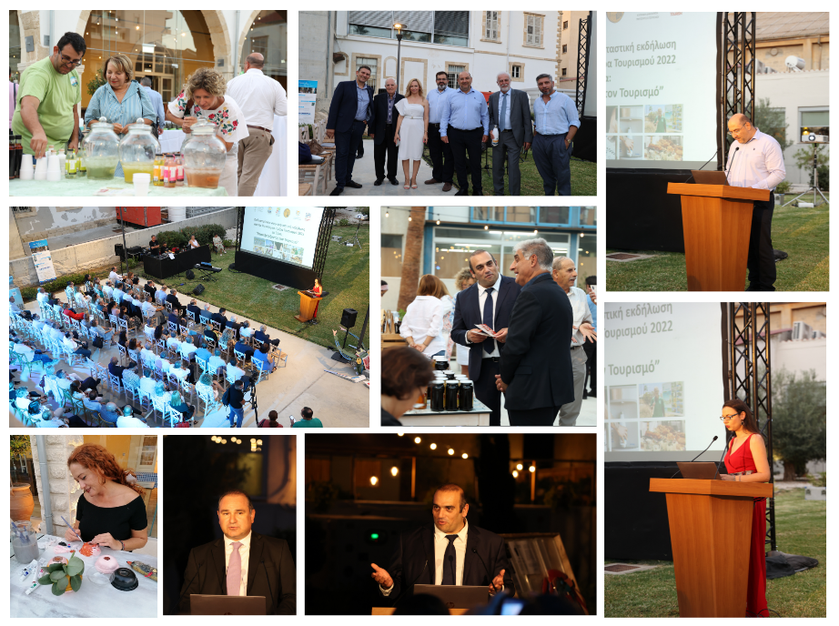
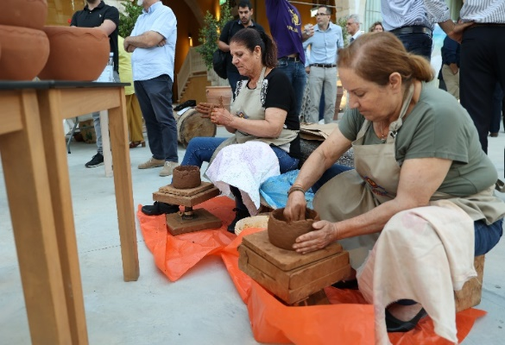
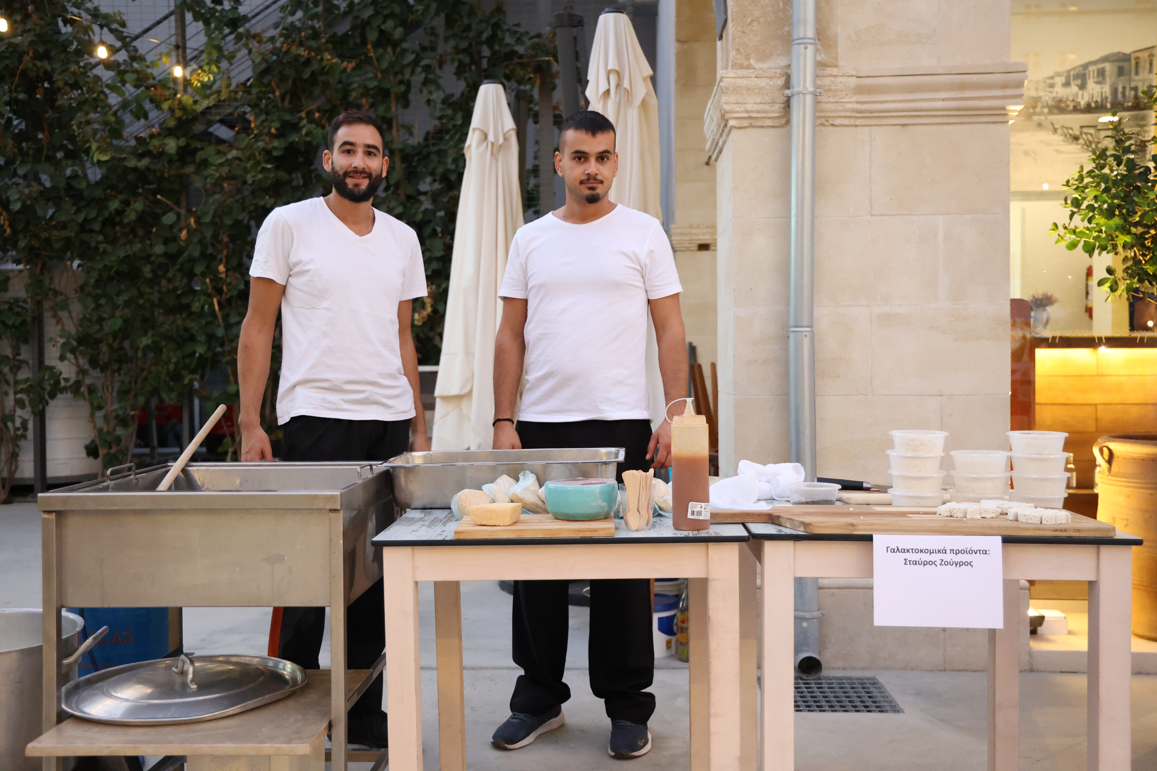
World Tourism Day Celebration: Rethinking Tourism
Tuesday 27.9.2022
Larnaka
2022
The festive event was organized by CSTI with the support of the Larnaka Tourism Board & Larnaka Municipality under the auspices of the Deputy Ministry of Tourism. We are grateful to all that contributed to the success of the event & made us rethink tourism & the tourism product of our country.

Slide 13
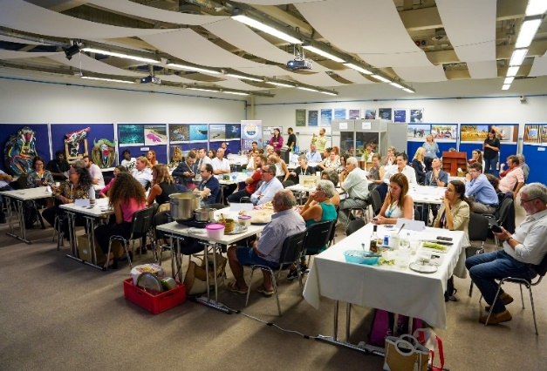
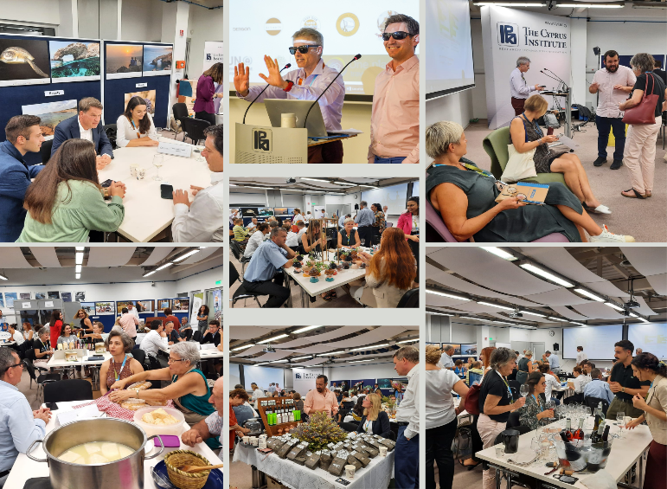
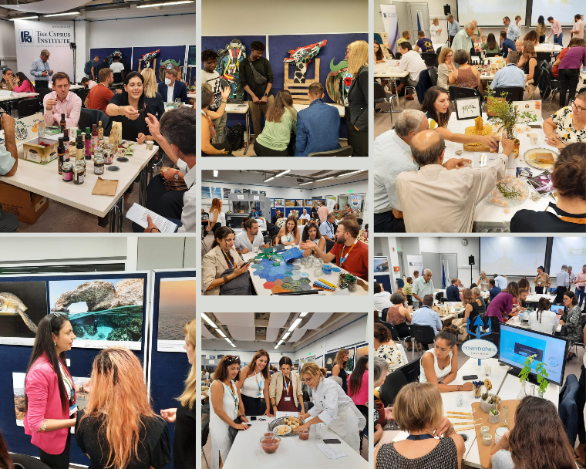
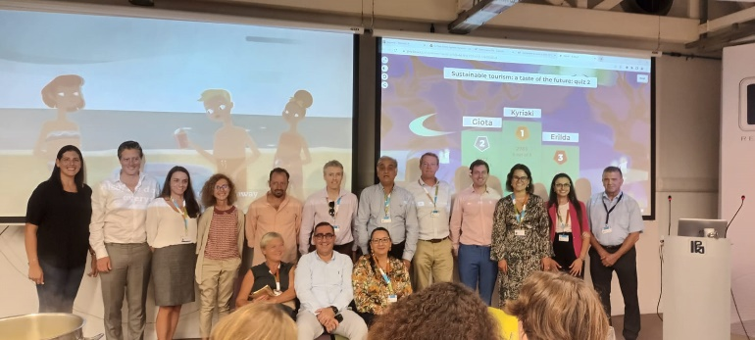
Sustainable Tourism: A Taste of the Future
Thursday 6.10.22
Nicosia
The Colorful Side Event of the 9th Environment for Europe Ministerial Conference: Transforming Planet was co-organized by the UN Environment Programme and CSTI. An Amazing Interactive event that gave the participants a positive taste from the Future of Sustainable Tourism.
2022

Slide 14
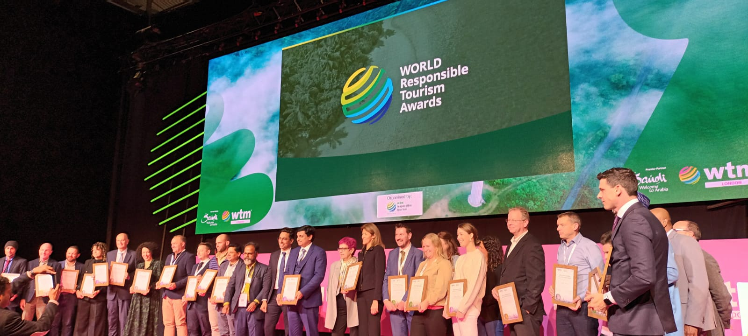
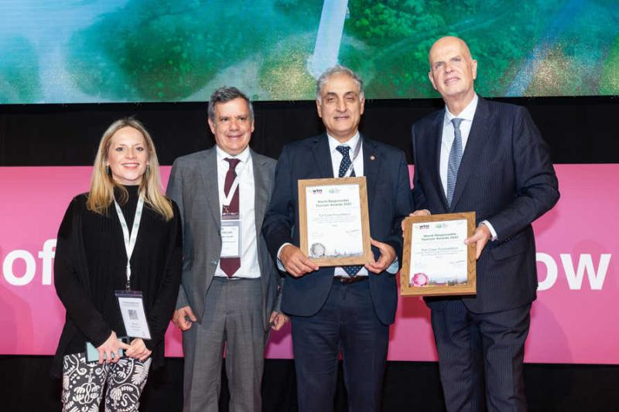
2022 WTM World Responsible Tourism Awards
London
Monday 7.11.2022
Silver Award for the
Keep our Sand and Sea Plastic Free, Destination Zero Plastic in Cyprus
TUI Care Foundation won the Silver Award for the above initiative under the category
“Reducing Plastic Waste in the Environment”
in the “Rest of the World” region.
Thomas Ellerbeck, the Chairman of the Board of Trustees of the
TUI Care Foundation received the award.
Also present at the ceremony were the partners that implemented Phase I of the project:
The Cyprus Sustainable Tourism Initiative (CSTI) & the Travel Foundation represented respectively by Philippos Drousiotis & Katie James..
The Cyprus Deputy Ministry of Tourism that supports the project was
represented by Vakis Loizides.
2022

Slide 15
Thanks for joining us on our exhilarating ride!
We look forward to continuing our
Action packed journey towards a
More Sustainable
&
More Responsible
Future
Together!
2006

Slide 16
Proud member of the Pancyprian Volunteerism Coordinative Council:
The Leading Organisation of Sustainable Tourism in Cyprus since 2006
THANK YOU!
CSTI is a launch partner & signatory of the:
Email: info@csti-cyprus.org
Website: www.csti-cyprus.org Facebook: www.facebook.com/csti.csti
Instagram: cysustainabletourisminitiative
LinkedIn: Cyprus Sustainable Tourism Initiative
Twitter: CSTI @CySustTourism
Hashtag: #LeadingSustainableTourisminCyprus
CSTI is a signatory of the:

